Slide 1

TYPESCRIPT
Async Programming
Callback Functions
Promises
Advanced Working of JavaScript
Comparison of Callbacks and Promises
Presenters:
Muhammad Bilal Akhtar
Wessam Aftab
Hamza Tariq
@bilal
@WessamAftab
@hamza

Slide 2
Synchronous Programming and JavaScript:
Sync Prog: Executing code:
sequentially,
line by line,
in the order it appears,
Performing one operation at a time,
While waiting for each task to finish before moving on to the next.
Single Threaded Language: Fundamental Characteristic of JavaScript. It means that JavaScript code runs in a single main thread => Sync Prog.
CHALLENGE! => Time consuming tasks => block the entire program => leading to unresponsive applications.

Slide 3
CHALLENGE! => Time consuming tasks => block the entire program => leading to unresponsive applications.
BLOCKING
Code that are slow to run

Slide 4
BLOCKING
Some examples:
console.log() is not slow
A loop from 1 to 10,000,000,000 is slow
Network request is slow
Image processing is slow

Slide 5
THE CALLSTACK
fun2InFun1(n, n)
fun1(n)
Last In First Out
main()
Responsible for tracking function execution sequentially.
One thread == One call stack == One task at a time

Slide 6
Example 1:
function after10Seconds(val){
// … Delay of 10 seconds
// … then return val + 1
}
let a = after10Seconds(1);
let b = after10Seconds(2);
let c = after10Seconds(3);
// done with the blocking functions
console.log(a);
console.log(b);
console.log(c);
main()
THE CALL STACK

Slide 7
function after10Seconds(val){
// … Delay of 10 seconds
// … then return val + 1
}
let a = after10Seconds(1);
let b = after10Seconds(2);
let c = after10Seconds(3);
// done with the blocking functions
console.log(a);
console.log(b);
console.log(c);
after10Seconds(1)
main()
THE CALL STACK

Slide 8
function after10Seconds(val){
// … Delay of 10 seconds
// … then return val + 1
}
let a = after10Seconds(1);
let b = after10Seconds(2);
let c = after10Seconds(3);
// done with the blocking functions
console.log(a);
console.log(b);
console.log(c);
after10Seconds(2)
main()
THE CALL STACK

Slide 9
function after10Seconds(val){
// … Delay of 10 seconds
// … then return val + 1
}
let a = after10Seconds(1);
let b = after10Seconds(2);
let c = after10Seconds(3);
// done with the blocking functions
console.log(a);
console.log(b);
console.log(c);
after10Seconds(3)
main()
THE CALL STACK

Slide 10
function after10Seconds(val){
// … Delay of 10 seconds
// … then return val + 1
}
let a = after10Seconds(1);
let b = after10Seconds(2);
let c = after10Seconds(3);
// done with the blocking functions
console.log(a);
console.log(b);
console.log(c);
console.log(a)
main()
THE CALL STACK

Slide 11
function after10Seconds(val){
// … Delay of 10 seconds
// … then return val + 1
}
let a = after10Seconds(1);
let b = after10Seconds(2);
let c = after10Seconds(3);
// done with the blocking functions
console.log(a);
console.log(b);
console.log(c);
console.log(b)
main()
THE CALL STACK

Slide 12
function after10Seconds(val){
// … Delay of 10 seconds
// … then return val + 1
}
let a = after10Seconds(1);
let b = after10Seconds(2);
let c = after10Seconds(3);
// done with the blocking functions
console.log(a);
console.log(b);
console.log(c);
console.log(c)
main()
THE CALL STACK

Slide 13
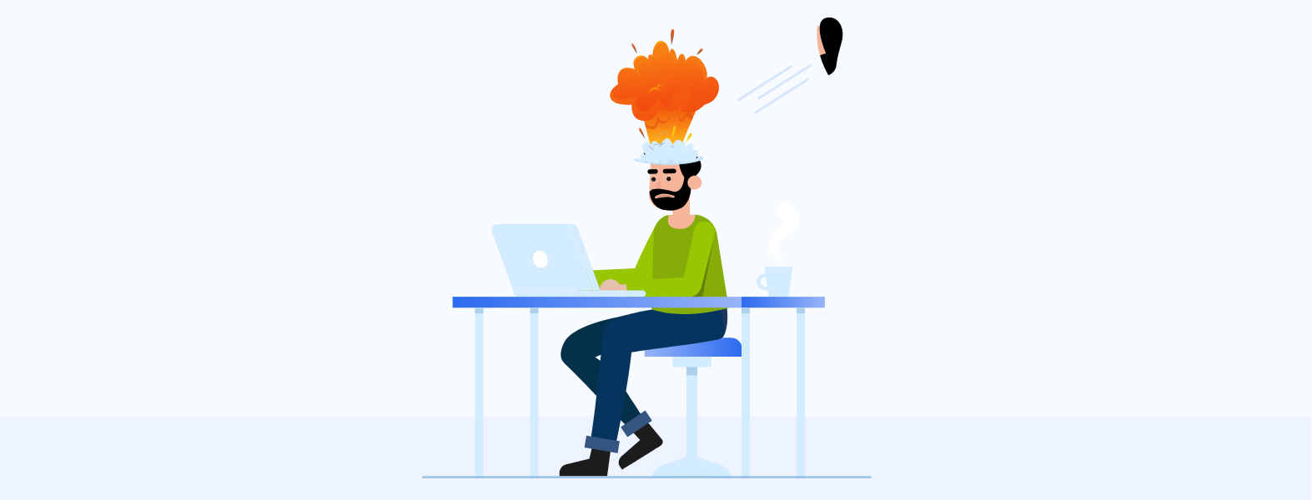
WHY IS THIS
A PROBLEM ?

Slide 14
THE SOLUTION ?
Asynchronous JS

Slide 15

I’m a
SINGLE-THREADED,
ASYNCHRONOUS,
CONCURRENT
language

Slide 16
I have a CALL STACK,
some others APIs,
an EVENT LOOP,
a CALLBACK QUEUE,
and stuffs…

Slide 17


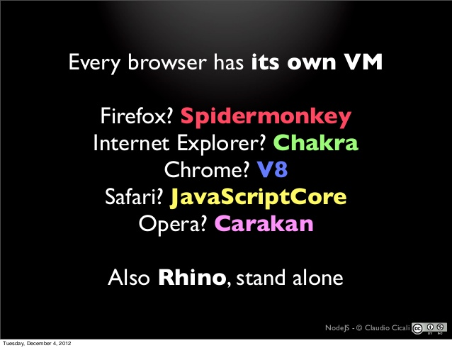

HEAP
STACK
WEB APIs
EVENT LOOP
CALLBACK QUEUE
* List of Alternative names for each component can be found in this linked slide

Slide 18
Web APIs:
Synchronous:
Call Stack manages sequential execution of the code.
Asynchronous:
VM engine interacts with external elements known as the Browser APIs.
The Browser API provides interfaces and functions for web developers to interact with web applications, including tasks like:
manipulating the Document Object Model (DOM),
setting timers,
making AJAX requests, and more.
Not native to JavaScript, enable dynamic and interactive web applications.

Slide 19
Example 2:
console.log(“Hi”);
setTimeout(function (){
console.log(“there”);
}, 5000);
setTimeout(function (){
console.log(“all”);
}, 0);
console.log(“PIAIC Students”);
CODE
STACK
WEB APIs
CONSOLE
EVENT LOOP
CALLBACK QUEUE

Slide 20
console.log(“Hi”);
setTimeout(function (){
console.log(“there”);
}, 5000);
setTimeout(function (){
console.log(“all”);
}, 0);
console.log(“PIAIC Students”);
CODE
STACK
WEB APIs
CONSOLE
main()
EVENT LOOP
CALLBACK QUEUE

Slide 21
console.log(“Hi”);
setTimeout(function (){
console.log(“there”);
}, 5000);
setTimeout(function (){
console.log(“all”);
}, 0);
console.log(“PIAIC Students”);
CODE
STACK
WEB APIs
Hi
console.log(“Hi”)
CONSOLE
main()
EVENT LOOP
CALLBACK QUEUE

Slide 22
console.log(“Hi”);
setTimeout(function (){
console.log(“there”);
}, 5000);
setTimeout(function (){
console.log(“all”);
}, 0);
console.log(“PIAIC Students”);
CODE
STACK
WEB APIs
timer
Hi
setTimeout 5 (callback1)
CONSOLE
main()
EVENT LOOP
CALLBACK QUEUE

Slide 23
console.log(“Hi”);
setTimeout(function (){
console.log(“there”);
}, 5000);
setTimeout(function (){
console.log(“all”);
}, 0);
console.log(“PIAIC Students”);
CODE
STACK
WEB APIs
setTimeout 5 (callback1)
timer
timer
Hi
setTimeout 0 (callback2)
CONSOLE
main()
EVENT LOOP
CALLBACK QUEUE

Slide 24

console.log(“Hi”);
setTimeout(function (){
console.log(“there”);
}, 5000);
setTimeout(function (){
console.log(“all”);
}, 0);
console.log(“PIAIC Students”);
CODE
STACK
WEB APIs
setTimeout 5 (callback1)
timer
setTimeout 0 (callback2)
timer
Hi
PIAIC Students
console.log(“PIAIC Stud”)
CONSOLE
main()
EVENT LOOP
CALLBACK QUEUE
callback2

Slide 25
console.log(“Hi”);
setTimeout(function (){
console.log(“there”);
}, 5000);
setTimeout(function (){
console.log(“all”);
}, 0);
console.log(“PIAIC Students”);
CODE
STACK
WEB APIs
setTimeout 5 (callback1)
timer
Hi
PIAIC Students
CONSOLE
main()
EVENT LOOP
CALLBACK QUEUE
callback2
callback1

Slide 26
WHAT DOES DO ?
EVENT LOOP
Asynchronous:
Event loop continuously checks the Call Stack and the Callback Queue.
If the Stack is empty, it takes the first element (pending task) in the Callback Queue, and pushes it into the Stack (processing in a non-blocking manner).
Event Loop empties in First In First Out order.
Although JavaScript is inherently single-threaded, the Event Loop provides a means for it to behave in a multi-threaded fashion, supporting asynchronous calls effectively.

Slide 27
console.log(“Hi”);
setTimeout(function (){
console.log(“there”);
}, 5000);
setTimeout(function (){
console.log(“all”);
}, 0);
console.log(“PIAIC Students”);
CODE
STACK
WEB APIs
Hi
PIAIC Students
all
CONSOLE
console.log(“all”)
EVENT LOOP
CALLBACK QUEUE
callback2
callback1

Slide 28
console.log(“Hi”);
setTimeout(function (){
console.log(“there”);
}, 5000);
setTimeout(function (){
console.log(“all”);
}, 0);
console.log(“PIAIC Students”);
CODE
STACK
WEB APIs
Hi
PIAIC Students
all
there
CONSOLE
console.log(“there”)
EVENT LOOP
CALLBACK QUEUE
callback1

Slide 29
console.log(“Hi”);
setTimeout(function (){
console.log(“there”);
}, 5000);
setTimeout(function (){
console.log(“all”);
}, 0);
console.log(“PIAIC Students”);
CODE
STACK
WEB APIs
Hi
PIAIC Students
all
there
CONSOLE
EVENT LOOP
CALLBACK QUEUE

Slide 30
Asynchronous Programming and JavaScript:
Asynchronous Programming:
Solution to the problem of blocking code in synchronous programming.
Allows multiple tasks to run concurrently, meaning they can overlap in execution.
Concurrency => Responsive Web Applications
Time exhaustive tasks, such as data fetching, animations, or user interactions, proceed independently without waiting for one another.
Asynchronous
Parallel
Concurrent

Slide 31
Methods for Asynchronous Programming:
Following methods may be used to introduce async behavior and to handle async operations, each with its own advantages:-
Callback functions: passing functions as arguments to handle asynchronous tasks (dependency management).
Promises: provide a more structured and readable way to manage asynchronous operations, offering better error handling and chaining capabilities.
The introduction of async / await in ECMAScript 2017 (ES8) further simplifies asynchronous code.

Slide 32
Methods for Asynchronous Programming:
Introducing Async Behavior: Allows to initiate tasks that can run in the background while the rest of the code continues executing.
Handling Async Behavior: Manage and handle the results of asynchronous operations once they complete.
Callback functions are executed when the task finishes.
Promises provide structured ways to handle success or failure.
async/await simplifies the process of working with asynchronous code by making it appear more synchronous while preserving non-blocking behavior.

Slide 33
Callback Function:
A callback function is passed as an argument to another function.
The callback will usually be executed after the code has finished.
You can create callback functions yourself by writing functions that accept a function as an argument, also known as higher-order functions.
Note that callbacks aren't by default asynchronous.

Slide 34
Example 3:
// Generalized Callback Function
function add(a, b) {
const result = a + b;
}
function displayResult(result) {
console.log(`The result is: ${result}`);
}
add(5, 3);
CODE
CONSOLE

Slide 35
Example 3:
// Generalized Callback Function
function add(a, b) {
const result = a + b;
}
function displayResult(result) {
console.log(`The result is: ${result}`);
}
add(5, 3, displayResult);
CODE
CONSOLE

Slide 36
Example 3:
// Generalized Callback Function
function add(a, b, cb:(n:number)=>void) {
const result = a + b;
}
function displayResult(result) {
console.log(`The result is: ${result}`);
}
add(5, 3, displayResult);
CODE
CONSOLE

Slide 37
Example 3:
// Generalized Callback Function
function add(a, b, cb:(n:number)=>void) {
const result = a + b;
cb(result);
}
function displayResult(result) {
console.log(`The result is: ${result}`);
}
add(5, 3, displayResult);
The result is: 8
CODE
CONSOLE

Slide 38
Example 4:
let syncF = () => {
console.log("I am sync... ");
}
function asyncFun() {
setTimeout(()=> {
console.log("I am NOT sync... ");
syncF();
}, 2000);
// syncF(); //Not fine if I want it after 2s
}
asyncFun();
syncF = () => {
console.log("I am sync TOO or TWO... ");
}
asyncFun();
I am NOT sync...
I am sync TOO or TWO...
I am NOT sync...
I am sync TOO or TWO...
CODE
CONSOLE

Slide 39
Example 5:
let syncF = () => {
console.log("I am sync... ");
}
function asyncFun() {
setTimeout(()=> {
console.log("I am NOT sync... ");
syncF();
}, 2000);
syncF();
}
asyncFun();
syncF = () => {
console.log("I am sync TOO or TWO... ");
}
asyncFun();
I am sync...
I am sync TOO or TWO...
I am NOT sync...
I am sync TOO or TWO...
I am NOT sync...
I am sync TOO or TWO...
CODE
CONSOLE

Slide 40
Example 6:
function carMaintenance(){
console.log("I leave my car at 9 in workshop");
setTimeout(() => {console.log("Car Fixed!")}, 2000);
}
function pickDress(){
setTimeout(() => {console.log("Dress Ready!")}, 10);}
console.log("Mechanic Response: ", carMaintenance());
setTimeout(() => {
console.log("Do grocery");
}, 0);
console.log("Laundry Response: ", pickDress());
I leave my car at 9 in workshop
Mechanic Response: undefined
Laundry Response: undefined
Do grocery
Dress Ready!
Car Fixed!
CODE
CONSOLE

Slide 41
CHALLENGE! => One function Dependent on Output(s) of other function(s) => Demands control over execution of async code (dependency management).
Use Callback Function
Need for synchronization in handling asynchronous tasks.
The output sequence depends on the completion of some other task(s).
To ensure desired order of execution of tasks (or in other words the desired sequence of output) => Use callback functions as arguments to setTimeout so that a task executes only after the completion of the previous one, effectively adding synchronous behavior to asynchronous code.

Slide 42
Real Life Examples of Dependency Management:
Data Loading and Rendering
Authentication and Authorization
Form Submission
Content Loading (Youtube, Facebook, …)
Multi-Step Workflows
Real-Time Updates (Chat Apps)
Data Dependencies (Displaying relevant data only)
File Uploads (Progress bar)
Error Handling

Slide 43
Example 7:
let syncF = () => {
console.log("I am sync... ");
}
function asyncFun( cb:()=>void) {
setTimeout(()=> {
console.log("I am NOT sync... ");
cb();
}, 2000);
//syncF();
}
asyncFun(syncF);
syncF = () => {
console.log("I am sync TOO or TWO... ");
}
asyncFun(syncF);
I am NOT sync...
I am sync...
I am NOT sync...
I am sync TOO or TWO...
CODE
CONSOLE

Slide 44
Example 8:
let syncF = () => {
console.log("I am sync... ");
}
function asyncFun( cb:()=>void) {
setTimeout(()=> {
console.log("I am NOT sync... ");
cb();
}, 2000);
syncF();
}
asyncFun(syncF);
syncF = () => {
console.log("I am sync TOO or TWO... ");
}
asyncFun(syncF);
I am sync...
I am sync TOO or TWO...
I am NOT sync...
I am sync...
I am NOT sync...
I am sync TOO or TWO...
CODE
CONSOLE

Slide 45
Example 9:
function carMaintenance(cb:(text:string)=>void){
console.log("I leave my car at 9 in workshop");
setTimeout(() => {cb("Car Fixed!")}, 2000);}
function carMaintCallBack(text:string){
console.log("Mechanic Response by CB: " , text);
pickDress(dressCallBack);}
function pickDress(cb:(text:string)=>void){
setTimeout(() => {cb("Dress Ready!")}, 10);}
function dressCallBack(text:string){
console.log("Laundry Response by CB: " , text);}
carMaintenance(carMaintCallBack);
setTimeout(() => { console.log("Do grocery");}, 0);
I leave my car at 9 in workshop
Do grocery
Mechanic Response by CB: Car Fixed!
Laundry Response by CB: Dress Ready!
CODE
CONSOLE

Slide 46
CHALLENGE! => Nested code => Increased complexity with length => Difficulty in Debugging
Callback Hell or Pyramid of Doom
Callback hell, also known as the "pyramid of doom," is a term used in programming to describe a situation where asynchronous operations are nested within each other, creating a deeply nested and hard-to-read code structure. It typically occurs when multiple asynchronous tasks depend on the results of previous ones, leading to a pyramid-like indentation pattern in the code. The code becomes complex, difficult to manage, and it is hard to find errors. => PROMISES!

Slide 47
Another CHALLENGE! Inversion of Control (IoC) => A phenomenon => We add intentionally => May be a drawback
Inversion of Control (IoC)
The concept of Inversion of Control (IoC) can be illustrated through the analogy of driving yourself (calling function) versus being driven by a taxi driver (callback function).

Slide 48
DEMOS WITH jsv9000

Slide 49
References:
https://www.slideshare.net/Designveloper-DSV/javascript-event-loop-64720816
https://wesbos.com/javascript/12-advanced-flow-control/66-the-event-loop-and-callback-hell
https://www.jsv9000.app/
http://latentflip.com/loupe/

Slide 50
Alternative Names for Components of JavaScript Runtime Environment:
JavaScript Engine: JavaScript interpreter, JavaScript virtual machine (JSVM), ECMAScript engine (V8 Engine)
Call Stack: Execution stack, control stack, function stack.
Heap: Memory heap, data heap.
Event Loop: Message loop, message dispatcher.
Callback Queue: Message queue, task queue, event queue.
Microtask Queue: Job queue, microtask list.
Macrotask Queue: Callback queue, Task queue, macrotask list.
Web APIs: Browser APIs, DOM APIs, platform APIs.
Promises: Promise objects, deferred objects.
Async/Await: Async functions, asynchronous functions, async/await syntax.
Event Handlers: Event listeners, event callbacks.
Timers: Timer functions, setTimeout, setInterval.

Slide 51
Standardization of Web APIs for Cross-Browser Compatibility:
Web APIs (Application Programming Interfaces) are typically standardized by organizations that oversee web standards. The primary organization responsible for web standards is the World Wide Web Consortium (W3C). They develop and maintain specifications for a wide range of web technologies, including HTML, CSS, and various web APIs.
The process typically involves collaboration between browser vendors (companies like Google, Mozilla, Apple, Microsoft, etc.) and other stakeholders in the web community. They work together to define and agree upon standards for web APIs to ensure compatibility and interoperability across different browsers.
Once a standard is agreed upon, browser vendors implement it in their respective browsers. This collaborative approach helps ensure that web developers can write code that works consistently across different browsers. However, there can still be some variations and nuances in how APIs are implemented, which is why thorough testing is important to ensure compatibility.
In addition to the W3C, there are other organizations and groups, such as the Web Platform Incubator Community Group (WICG), that work on evolving web standards and developing new APIs. The goal is to keep the web platform modern, secure, and feature-rich while maintaining compatibility.

